Slide 1

SWD 392 - Software Architecture and Design

Slide 2
SWD392
Static Modeling

Slide 3
Design Concepts Objects and Classes
Objects represent ‘’thing’’ in real world
  - Provide understanding of real world
  - Form basis for a computer solution
An Object (object instance) is a single ‘’thing’’
  - E.g., an account, an employee
A Class (object class) is a collection of objects with the same characteristics
  - E.g., account, employee
Atrribute
  - Data value held by objects in class
  - E.g., account number, balance

Slide 4
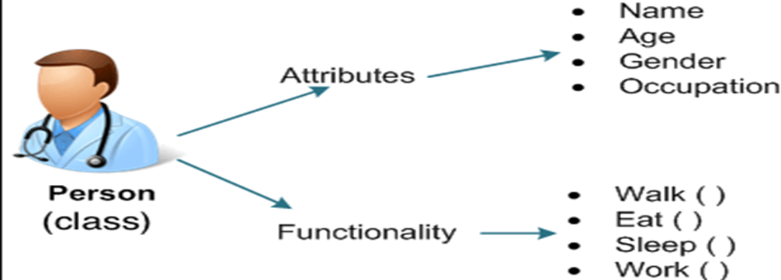
Example of classes and objects

Slide 5
Static Modeling
Define structural relationships between classes
  Depict classes and their relationships on class diagram
Relationships between classes
  Associations
  Composition / Aggregation
  Generalization / Specialization
Static Modeling during Analysis
  System Context Class Diagram
    Depict external classes and system boundary
  Static Modeling of Entity classes
    Persistent classes that store data

Slide 6
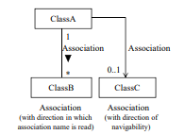
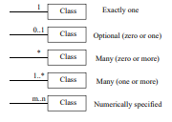
UML notation for relationship on class diagram

Slide 7
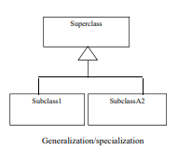
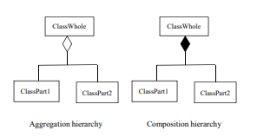
UML notation for relationship on class diagram

Slide 8
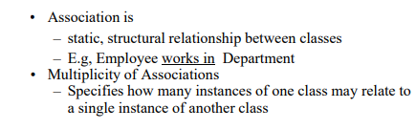
What is Associations

Slide 9
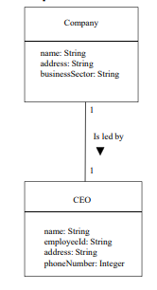
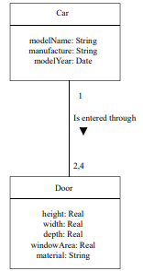
Example
Numerically specified association
One-to-one association

Slide 10
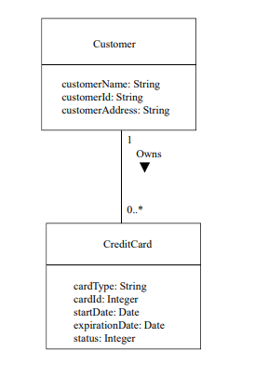
Example
Optional (zero, one, or many) association

Slide 11
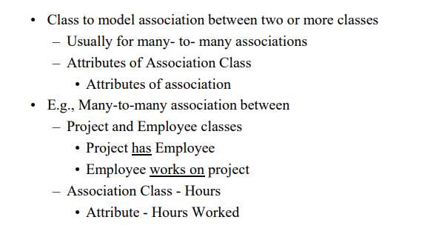
Association Class

Slide 12
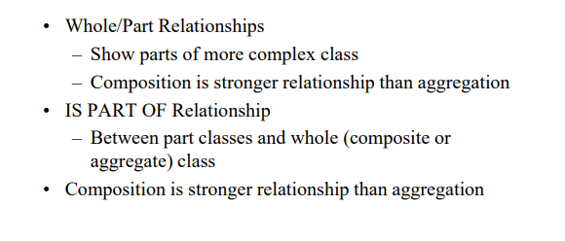
Composition/Aggregation Hierarchy

Slide 13
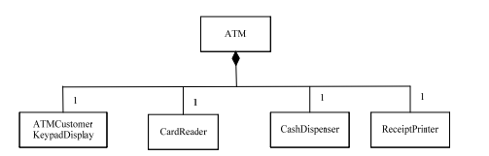
Example of composition hierarchy

Slide 14
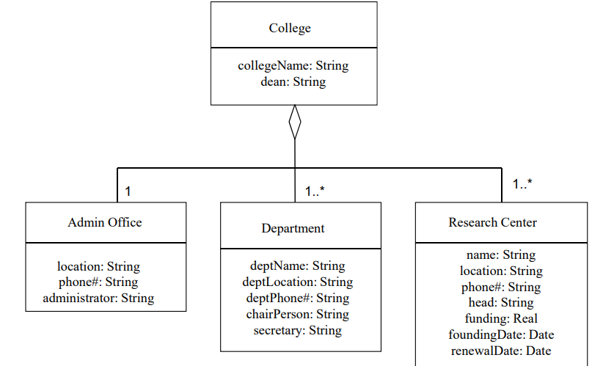
Example of aggregation hierarchy

Slide 15
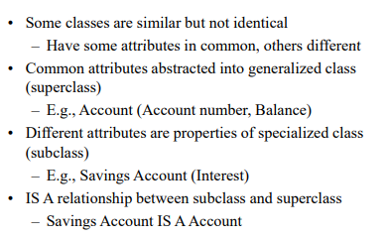
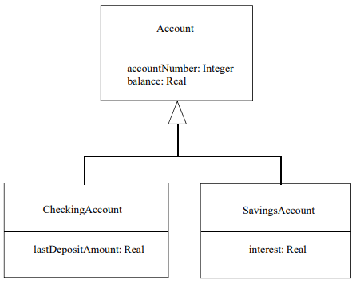
Generalization / Specialization Hierarchy

Slide 16
Generalization / Specialization Hierarchy

Slide 17
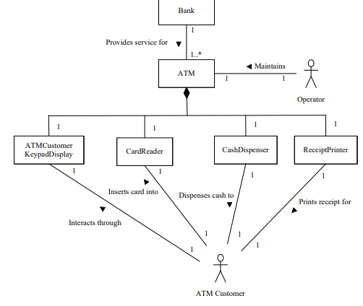
Conceptual static model for Banking System

Slide 18
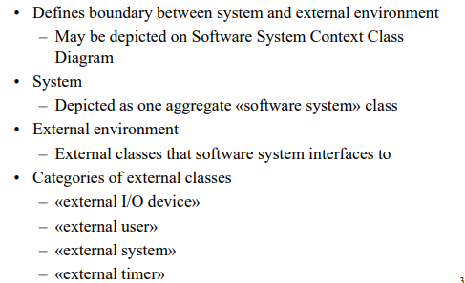
Software System Context Class Diagram

Slide 19
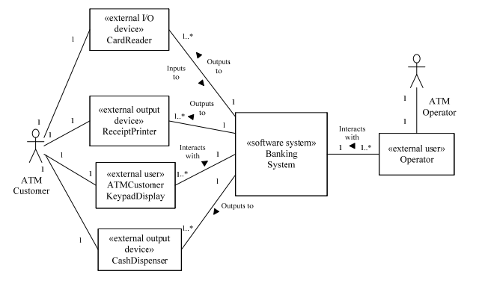
Banking System software context class diagram

Slide 20
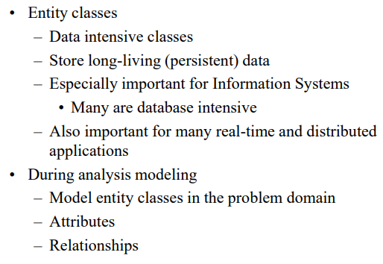
Static Modeling of Entity Classes

Slide 21
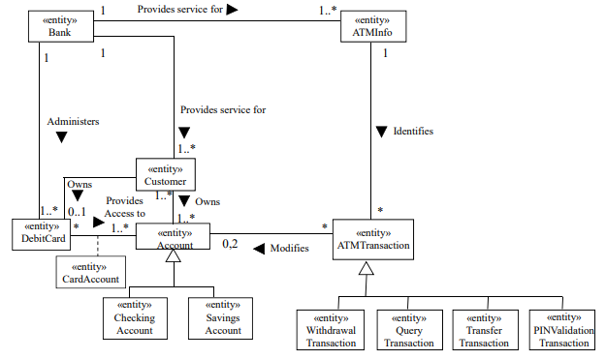
Conceptual static model for Banking System - entity classes

Slide 22
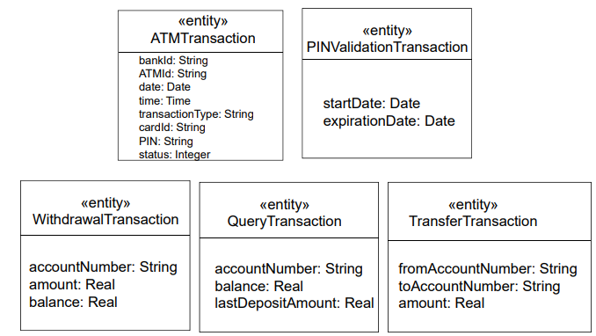
Conceptual static model for Banking System

Slide 23
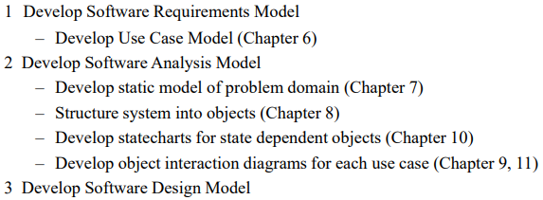
Steps in Using COMET/UML

Slide 24
Thanks!
Does anyone have any questions?
CREDITS: This presentation template was created by Slidesgo, including icons by Flaticon, infographics & images by Freepik
Please keep this slide for attribution

